Slide 1

Firewall Traffic
SVM SGD – Dawkins, Deinlein, Lazarus, Rudkc
GitHub

Slide 2

Business Overview and Objectives
Current system taking up a lot of manpower and resources.
Why?
The goal of this case study is to build a program to programmatically ‘accept’ or ‘deny’ requests coming in on network traffic for the client company.

Slide 3
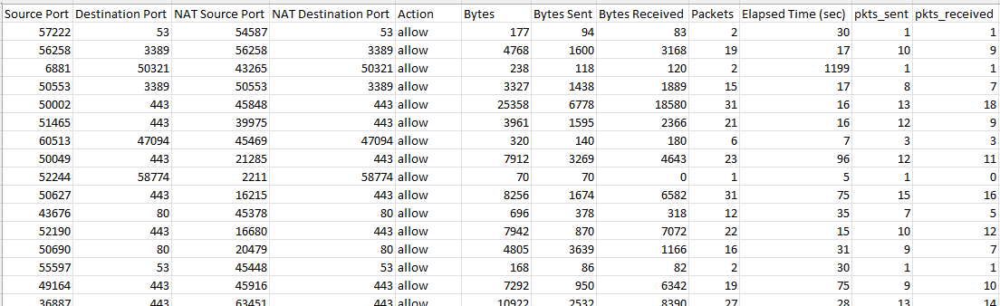

Data Description
Categorical Variables
Source Port: Categorical feature with 22,692 unique Port ID’s
Destination Port: Categorical feature with 3264 unique Port ID’s
NAT Source Port: Categorical feature with 29,143 unique Port ID’s
NAT Destination Port: Categorical feature with 2533 unique Port ID’s
Continuous Variables
Bytes
Bytes Sent
Bytes Received
Elapsed Time
Pkts Sent
Pkts Received
Target Variable
Action: Categorical Feature with 4 levels.
This was changed to 2 levels. 1 for Allow, 0 for all others.

Slide 4

Data Description ‘Action’
Allow – 37640
Deny – 14987
Drop – 12851
Reset-Both - 54
Requested to programmatically make decision to Accept or Deny
The team Made the decision to combine Deny and Drop into one category.
Also found

Slide 5
Data Engineering
Duplicates: Searching the Data we found 8,362 rows that were exact duplicates. We decided not to remove these observations from the data set:
Allow – 201
Deny - 8161
Action: New comparison of Allow and Deny after removal of Duplicates and combining Deny and Drop
Allow(1) – 60%
Deny(0) – 40%

Slide 6
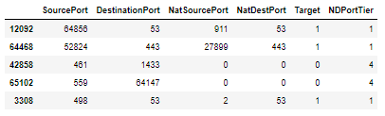

Feature Engineering
Removed Continuous Features:
Data Leakage: Most of the continuous variables are recorded during an active connection. They would not be available for a model looking to allow or deny at onset.
Port Addresses:
Data available time of prediction: Categorical feature that normally denotes what part of the system a call is trying to access. Calls to ports not listed or used is normally a situation where there is an attack or a port where no response can or should be made.
We grouped port access into a risk categorical variable based on the likelihood to accept or deny access.

Slide 7
Model Preparation
Once we created our risk level tier, we mapped it back to our original data.
We then removed all other categorical features that would have caused a sparce dataset.
Finally, we one hot encoded our categorical variable.
Train test for the model was a test set of 20% since SVM's take very long to train. The test set was allowed to be 80%. There were more than enough observations to allow for train test instead of cross validation.

Slide 8
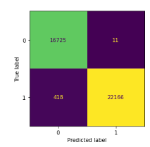
Model Building
We evaluated the model on a number of metrics. The main one being f1-score to try to balance recall and precision.
Our F1 score came in at .99. While this is high, this problem is really less of an ML issue and more of a business rule of Blacklisting and whitelisting port access.
39,320 – N. of test observations
418 -times our model said ‘Deny’ (0) when it should have been ‘Allow’ (1)
11 – times our model said ‘Allow’ (1) when should have been ‘Deny’ (0)

Slide 9
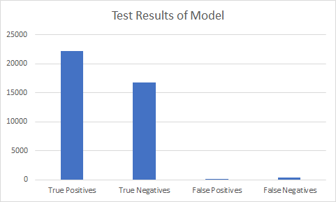
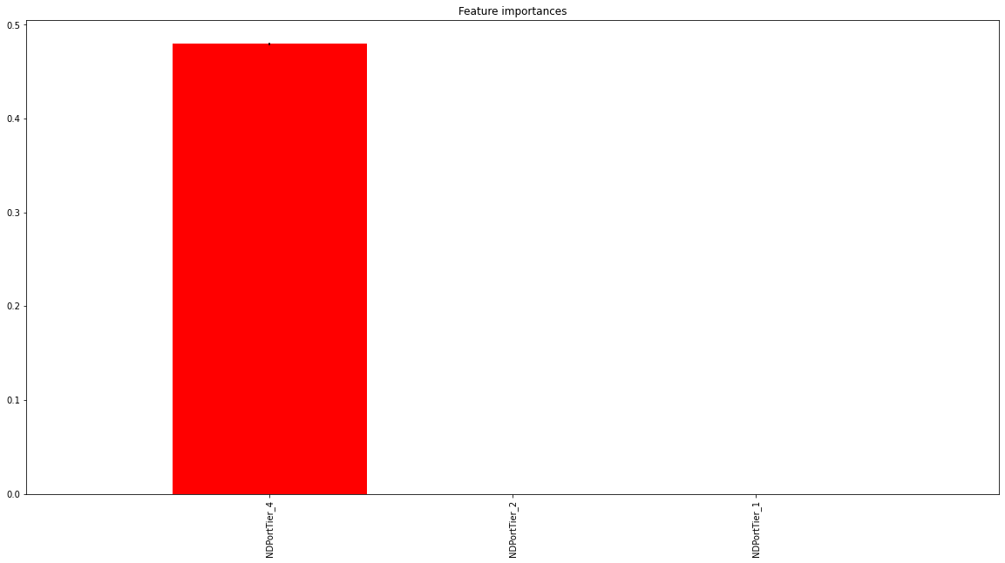
Model Evaluation & Interpretation
By creating our on NB prior feature we saw excellent results of true-positives and true-negatives with few misclassifications.
The most important features was whether a port belonged to tier_4 risk group or not. This is to be expected as tier_4 were almost always rejected and the other tiers had at least some acceptance rate.

Slide 10
Conclusions
Because ports are static this model will be useful as the priors will serve to group ports into risk tiers for accepting or denying. As new ports begin to be used, they will go into a new group 0 automatically, this will allow the model to flex giving access sometimes and not others. As the port comes into more use or can be whitelisted, it can be added to the appropriate risk tier.
It is our basic belief based on the data provided that using a business rule decision tree might be more cost effective and easier to set up than an active model.

Slide 11
Discussions
Question to the Partner: Is it cost effective or is there much to be gained by using a business rule structure to a dynamic model?
How to Improve: Expanded data set would be helpful to help create a more dynamic model if features like IP address were available.
Next Steps: Decision on whether to continue down route of implementing a model or using a business rule list with a dedicated whitelist and blacklist. We also need to continue to collect data. There were a number of ports that only had only a couple contacts on them. This means that our model for accepting or rejecting those ports will be more biased than those ports that had a lot of traffic on them.

Slide 12
Appendix
https://github.com/JosephLazarus/QTW/blob/main/Case%20Study%205/Case%20Study%205.ipynb
Notes:
Photo by freepik

